Slide 1
Gene Expression Correlates in a Rat Model of Gulf War Illness
Steve Semick
November 19th, 2019
MSRD - O.04

Slide 2
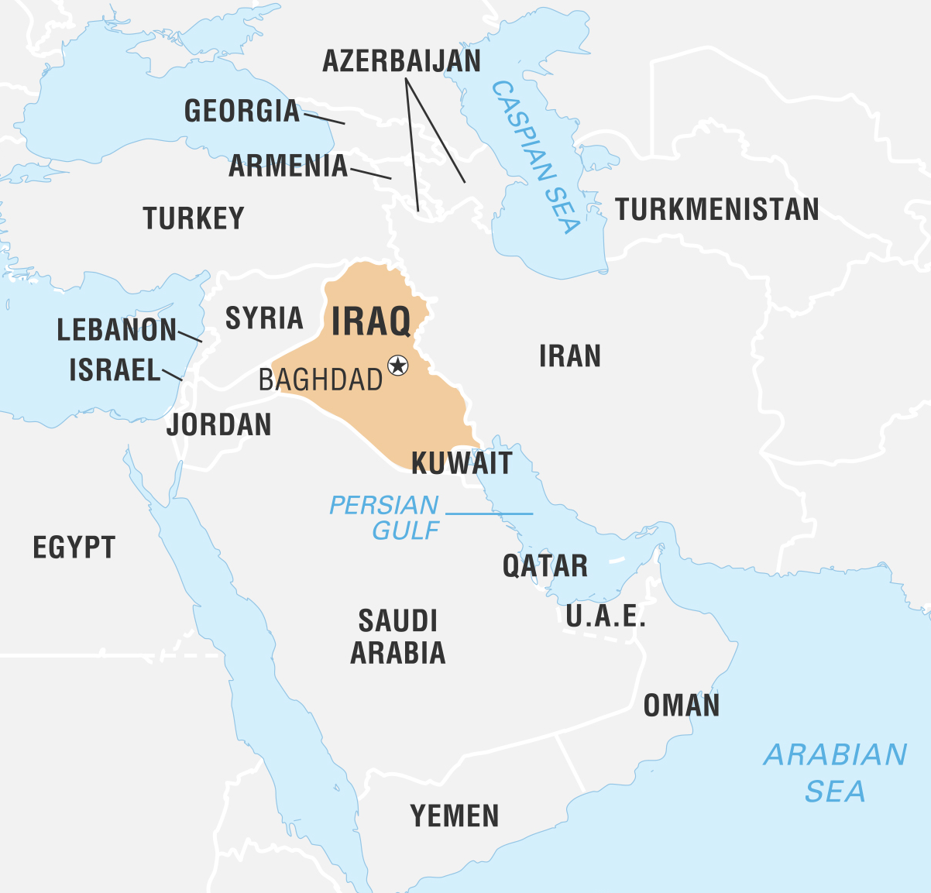

Background – Persian Gulf War
Conflict between Iraq and U.S. & coalition forces (1990-1991)
~700,000 U.S. service members deployed
Exposure to potential neurotoxicants
Pyridostigmine (PYR) – prophylaxis against sarin
Lipopolysaccharide (LPS) – desert sand
Smoke from oil-well fires
Wikimedia Commons

Slide 3
Background – Gulf War Illness
~250,000 veterans with persistent multi-symptom illness
fatigue
headache
memory problems
rash
arthralgia / myalgia
gastrointestinal upset
No known molecular etiology
Limited therapeutics

Slide 4
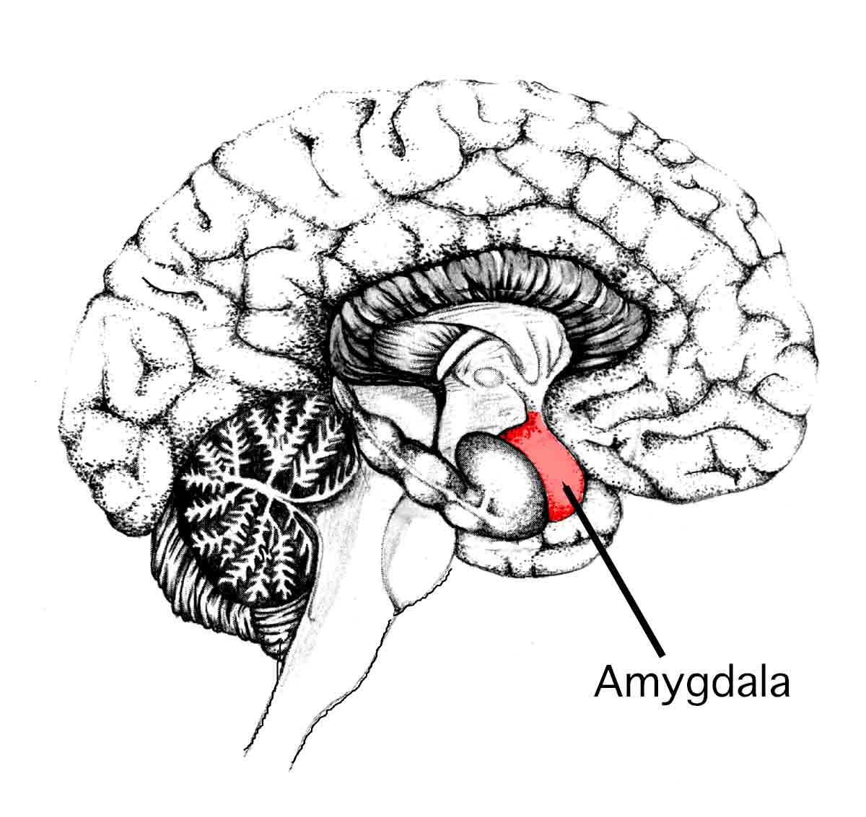
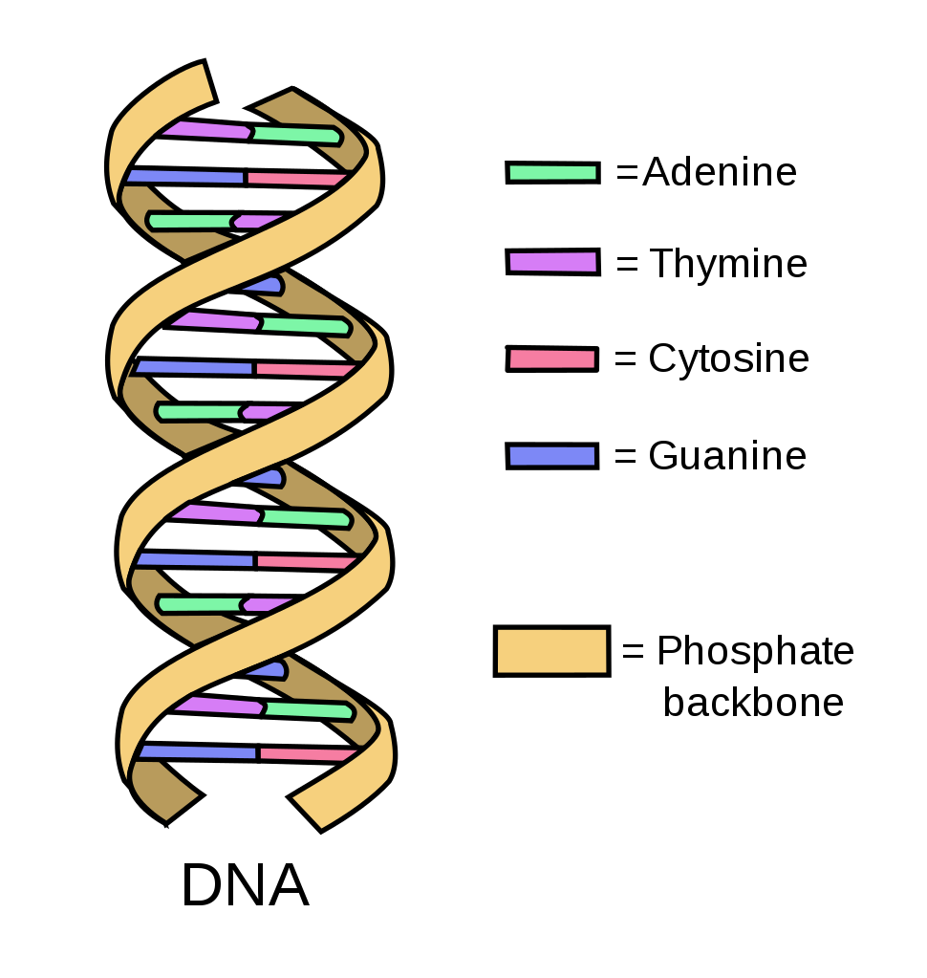


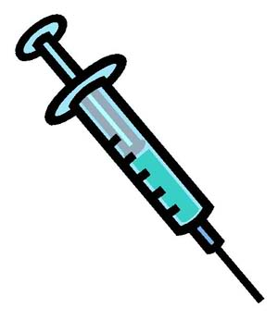
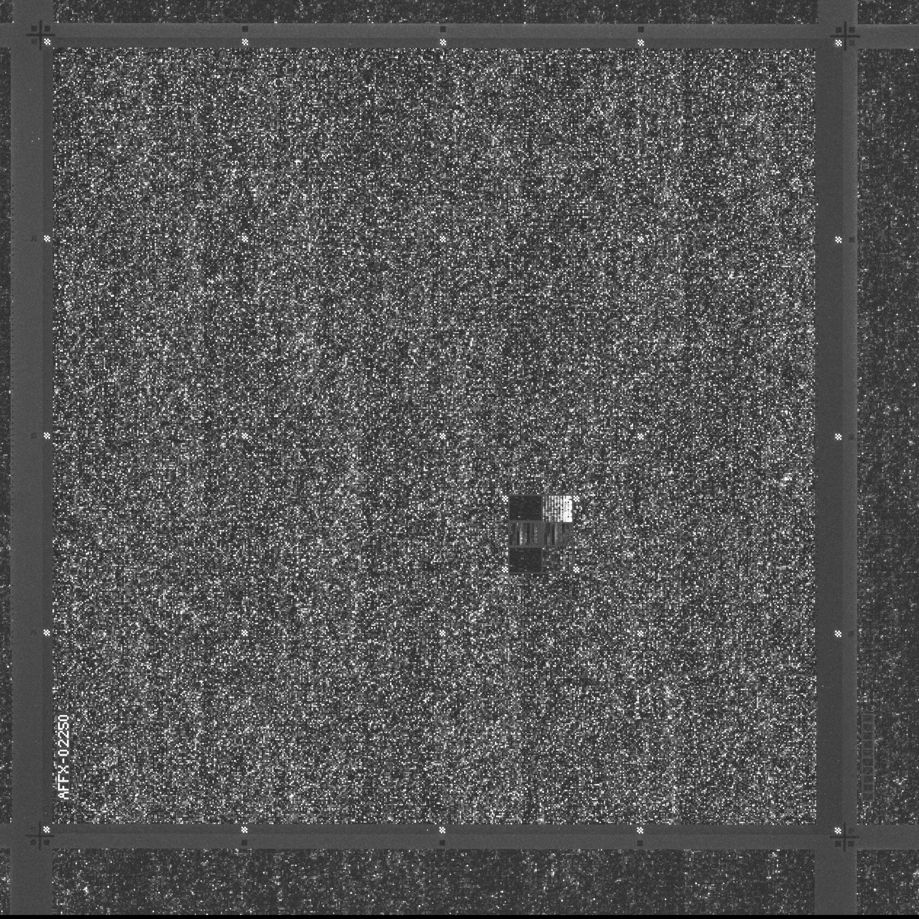

Methods
Rat model of
Gulf War Illness
Brain region extractions
Microarray Profiling
Control (N=3)
Frontal
cortex
LPS + PYR (N=2)
RNA
Lateral amygdala (LA) and frontal cortex (FC) extracted from each rat
Clariom S Microarray (23,188 transcripts)
LPS + PYR +
rosiglitazone (N=3)

Slide 5
167 differentially expressed genes
Control
LPS + PYR

Slide 6
Top differentially expressed genes
Symbol | Region Significance | Min P | FC log2 fold change | LA log2 fold change
LOC100911867; Pnpla7 | Both Sig | 2e-6 | -1.4 | -0.9
Slpil2 | LA Sig | 4e-6 | -0.3 | 1.4
Taar7e | LA Sig | 5e-6 | 0.3 | 1.3
Rad21l1 | FC Sig | 5e-6 | 1.8 | 0.8
LOC100363064 | LA Sig | 6e-6 | 0.2 | 1.3
Six6os1 | LA Sig | 9e-6 | 0.1 | 1.9
Napepld | FC Sig | 1e-5 | -1.3 | -0.4
Fosb | Both Sig | 1e-5 | -2.4 | -1.8
LOC100910418 | FC Sig | 1e-5 | -1.8 | -1.0
Junb | Both Sig | 1e-5 | -1.8 | -2.1

Slide 7
Stronger effects of GWI on lateral amygdala gene expression than frontal cortex
138 differentially expressed genes in lateral amygdala compared to 38 in frontal cortex
Brain region was the largest driver of overall gene expression variation

Slide 8
Gene Ontology – Biological Processes
Description | Direction | FC Adjusted P | LA Adjusted P
response to glucocorticoid | Down | 0.006 | 2E-05
response to organophosphorus | Down | 0.0002 | 2E-05
T cell differentiation | Down | 0.03 | 0.01
cellular response to environmental stimulus | Down | 0.02 | 0.01
regulation of leukocyte differentiation | Down | 0.005 | 0.02
circadian regulation of gene expression | Down | 0.008 | 0.03

Slide 9
Heatmap of differentially expressed genes in lateral amygdala

Slide 10
Rosiglitazone reversal of gene expression changes
Gene expression changes with rosiglitazone treatment inversely correlated with GWI injury changes (p < 2.2e-16, r= -0.911)
Vs.
Vs.

Slide 11
Summary
Specific gene expression changes induced with Gulf War Illness model
Differential expression stronger in lateral amygdala and possibly related to neuroinflammation
Partial reversal of expression changes with rosiglitazone, a PPAR-gamma agonist
Ongoing work to replicate findings in repeat experiment

Slide 12
Thank you
J. Marc Simard
Vladamir Gerzanich
Seung Woo
Orest Tsymbalyuk
Kaspar Keledjian

